Slide 1
Key-Value Extraction

Slide 2
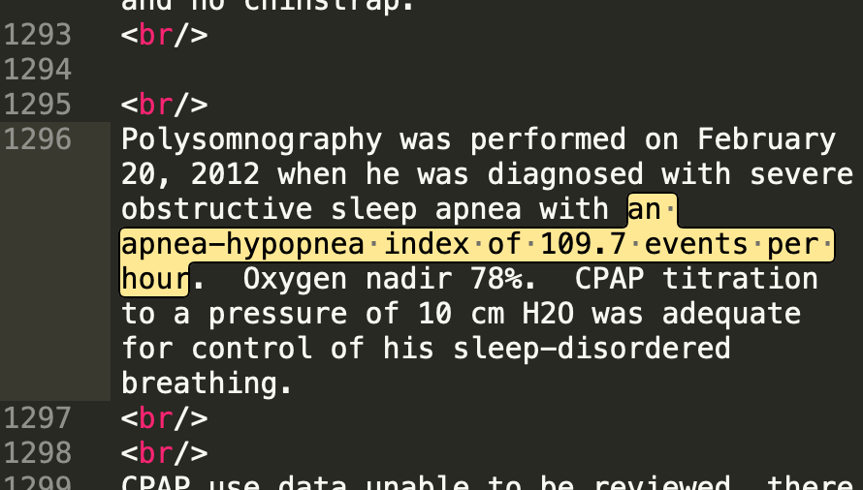
Example: Extracting Sleep apnea information from EHR
NLP
AHI | 109.7
… | …

Slide 3
Problem Description
Extracting key terms and corresponding values from text
Key terms can be defined as any terminologies
person, location, event, weather in news
brand, size, color in e-commerce
medical condition or treatment in medical notes
Value is defined as key’s corresponding value
Example: His ahi was 16. 1, supine was 27. 3, which categorizes him as having moderate sleep apnea.
In this example: ahi, supine are two medical conditions, and 16.1, 27.3 are values, respectively. And our goal is to recognize target medical conditions and their corresponding values as key-value pairs.

Slide 4
Challenges detecting key terms
No fixed pattern when referring to a target terminology
Nature of unstructured text data
Complexity of medical language
Common/uncommon abbreviations, typos and variations of a terminology
Terms can appear in incomplete sentences, phrases or chunk of words making it hard to make use of POS
AHI is 5.8 | the current average AHI is 5.8 which is
AHI index of 2.7 | This resulted in an AHI index of 2.7 with 82 minutes
AHI 60 | Date: 8/5/2008 TST 156 AHI 60 SpO2 nadir 80% on CPAP auto 5-10
AHI 5.6/hr | Mild with AHI 5.6/hr with nocturnal hypoxemia
AHI of 29 | moderate osa With a AHI of 29 and she is set at 12 cmh20 she also has a parasomnia.
AHI: 5 | OSA (obstructive sleep apnea) Mild (AHI: 5)
AHI of 15.0/hour | his NPSG revealed obstructive sleep apnea with an AHI of 15.0/hour and oxygen
AHI 75/hr | severe obstructive sleep apnea with an AHI 75/hr, average SpO2 of 89.9%
apnea-hypopnea index of 20 | his baseline apnea-hypopnea index of 20. Average
apnea/hypopnea index of 2.7 events per hour | revealed an apnea/hypopnea index of 2.7 events per hour and oxygen
apnea-hypopnea index of 6 | revealed mild structured sleep apnea with an apnea-hypopnea index of 6. His apnea
BIRADS 2
BiRad:1
BI-RADS 0
BI-RADS: 2
BI-RADS:1
BI-RADS-3
BI-RADS Category: 2
BI-RADS CATEGORY 1
BIRADS Category 0A
BI-RADS CATEGORY (2)
BIRADS Category 2
BIRADS - CATEGORY 2
BIRADS CODE: 6

Slide 5
Problem Solution
Initial rule-based model
No labelled data initially
Based on regular expressions and pattern matching
1.6% false positive rate on the sleep apnea model
0% false positives on mammogram and peripheral vascular disease model
A general deep learning model to extract key-value pair information
Have successfully applied our model to medical notes.
Can be applied to any similar scenario.
Can be scaled up to thousands of keys (terms, attributes, entities) without being restricted to only a few standard types of keys.

Slide 6
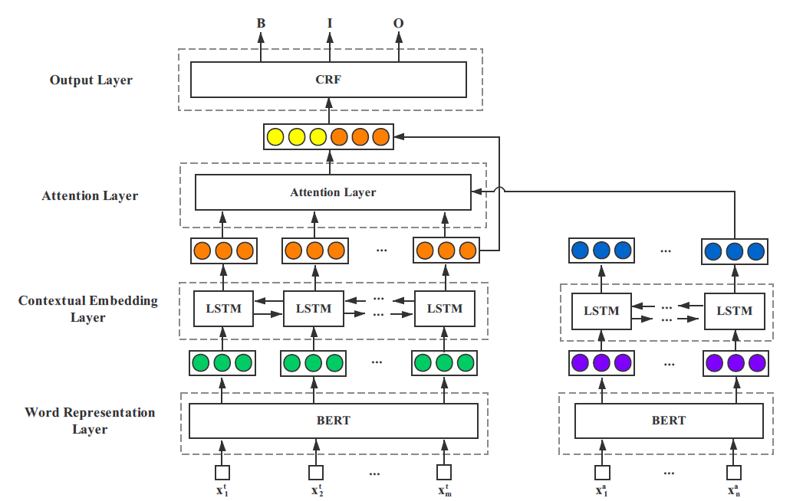
Model Description[1]
Output: [start_pos, end_pos] (16.1)
Model Input:
Text: any text or notes
Key: terms you’re interested
Model Output:
[Start_pos, end_pos] of the value that is relevant
to the key. If there no relevant value for the key, the
output will be NULL
[1] Xu, Huimin, et al. "Scaling up open tagging from tens to thousands: Comprehension empowered attribute value extraction from product title." Proceedings of the 57th Annual Meeting of the Association for Computational Linguistics. 2019.
Text: His ahi was 16. 1, supine was 27. 3, which categorizes him as having moderate sleep apnea
Key: AHI

Slide 7
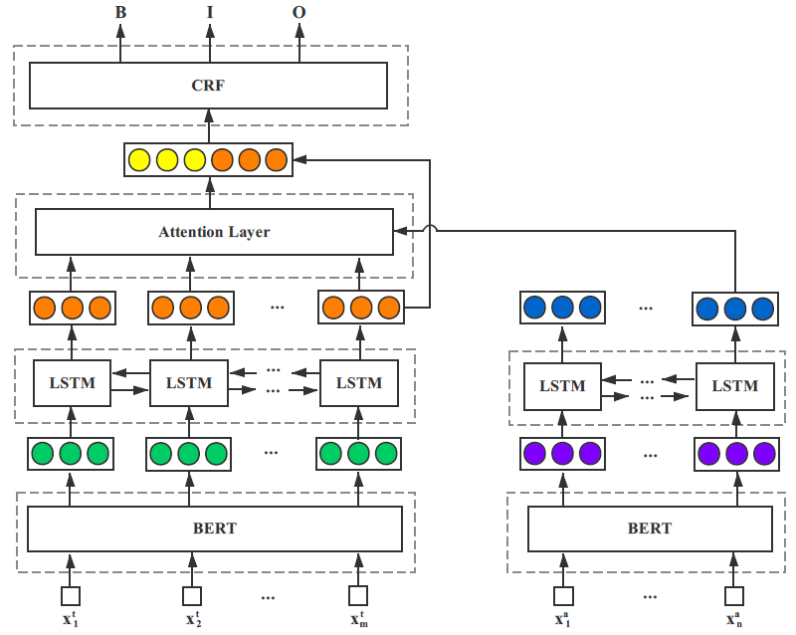

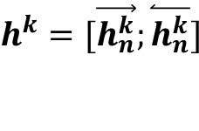
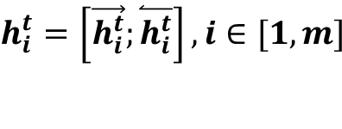
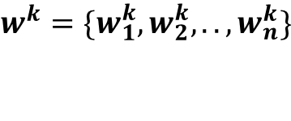

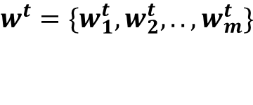
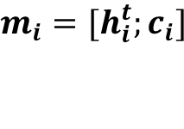
Model Details
$$m_{i}={[h}_{i}^{t};c_{i}]$$
$$α_{i}=cosine(h_{i}^{t},h^{a})$$
$$c_{i}=h_{i}^{t}·α_{i}$$
$$h_{i}^{t}=\left[\vec{h_{i}^{t}};\overset{⃐}{h_{i}^{t}}\right], i∈[1,m]$$
$$h^{k}=[\vec{h_{n}^{k}};\overset{⃐}{h_{n}^{k}}]$$
$$w^{t}=\{w_{1}^{t},w_{2}^{t},..,w_{m}^{t}\}$$
$$w^{k}=\{w_{1}^{k},w_{2}^{k},..,w_{n}^{k}\}$$
Text
Key

Slide 8
Sample Results
Baseline model (without fine tuning) results on medical notes look good.
Examples of Model output
Text: history of undescended testicle osa on cpap 2008 ahi 56. 8 on home study in 2013, on autocpap 10 - 14 pure hypercholesterolemia has been taking lipitor every other day.
Key: AHI
Output: 56.8
Text: medical interpretation : percent days 4 hours use = 67 % average ahi = 0. 2 / hr large leak rare current setting : 7 - 9 cm h20
Key: AHI
Output: 0.2 / hr
Accuracy | Recall | F1-Score
0.83 | 0.87 | 0.85

